Slide 1
Web scraping task to gain company insights
The insights were derived from the extraction, transformation, loading (etl), and analysis of text dataset of 3442 British Airways customer reviews from Skytrax webpage.
Topic modelling using Latent Dirichlet Allocation (LDA) Analysis indicated the dominant topic, most discussed keywords in the review document as seat, flight, food, good, crew, 1hr, cabin, service, time, ba, and percentage contribution in the review document as 0.975.
Wordcloud visualization indicated the most frequently used words in the review as flight,ba,british airways, time, good, seat, service, passenger, staff, business class, cabin crew, food, airport, great, nice, excellent. Quick insight, passengers shared their experience with food served on the plane, the aircraft seats, business class experience, and services received from the cabin crew as well as interactions with airport elements.
Sentiment analysis of Top 3 Random Reviews with highest Polarity
Review 1 was grateful for excellent premium host service and time management
Review 2 was appreciated the good seat
Review 3, was appreciative of the great, excellent service from the cabin crew.
Sentiment analysis of Top 3 Random Review with lowest Polarity
Review 1 complained about luggage allowance, horrible flight.
Review 2 complained about the food i.e. chicken wrap being horrible, inedible , disgusting sausage and inedible hash brown, advised potential passengers to have traditional breakfast, rubbish ba.
Review 3. complained about the croissant cream cheese onion breakfast fruit bar, wrap cellophane, couldn't eat it but wasted it.

Slide 2
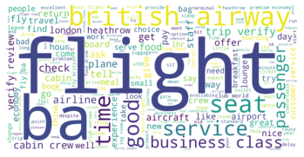
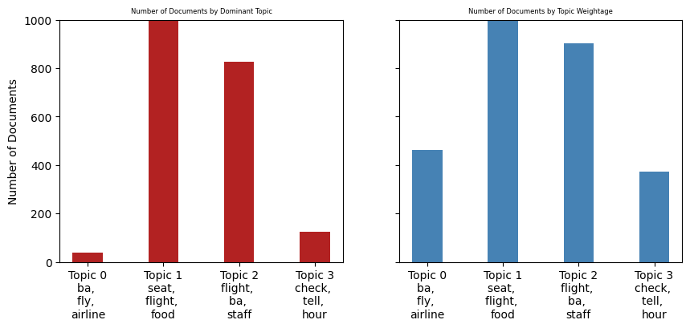
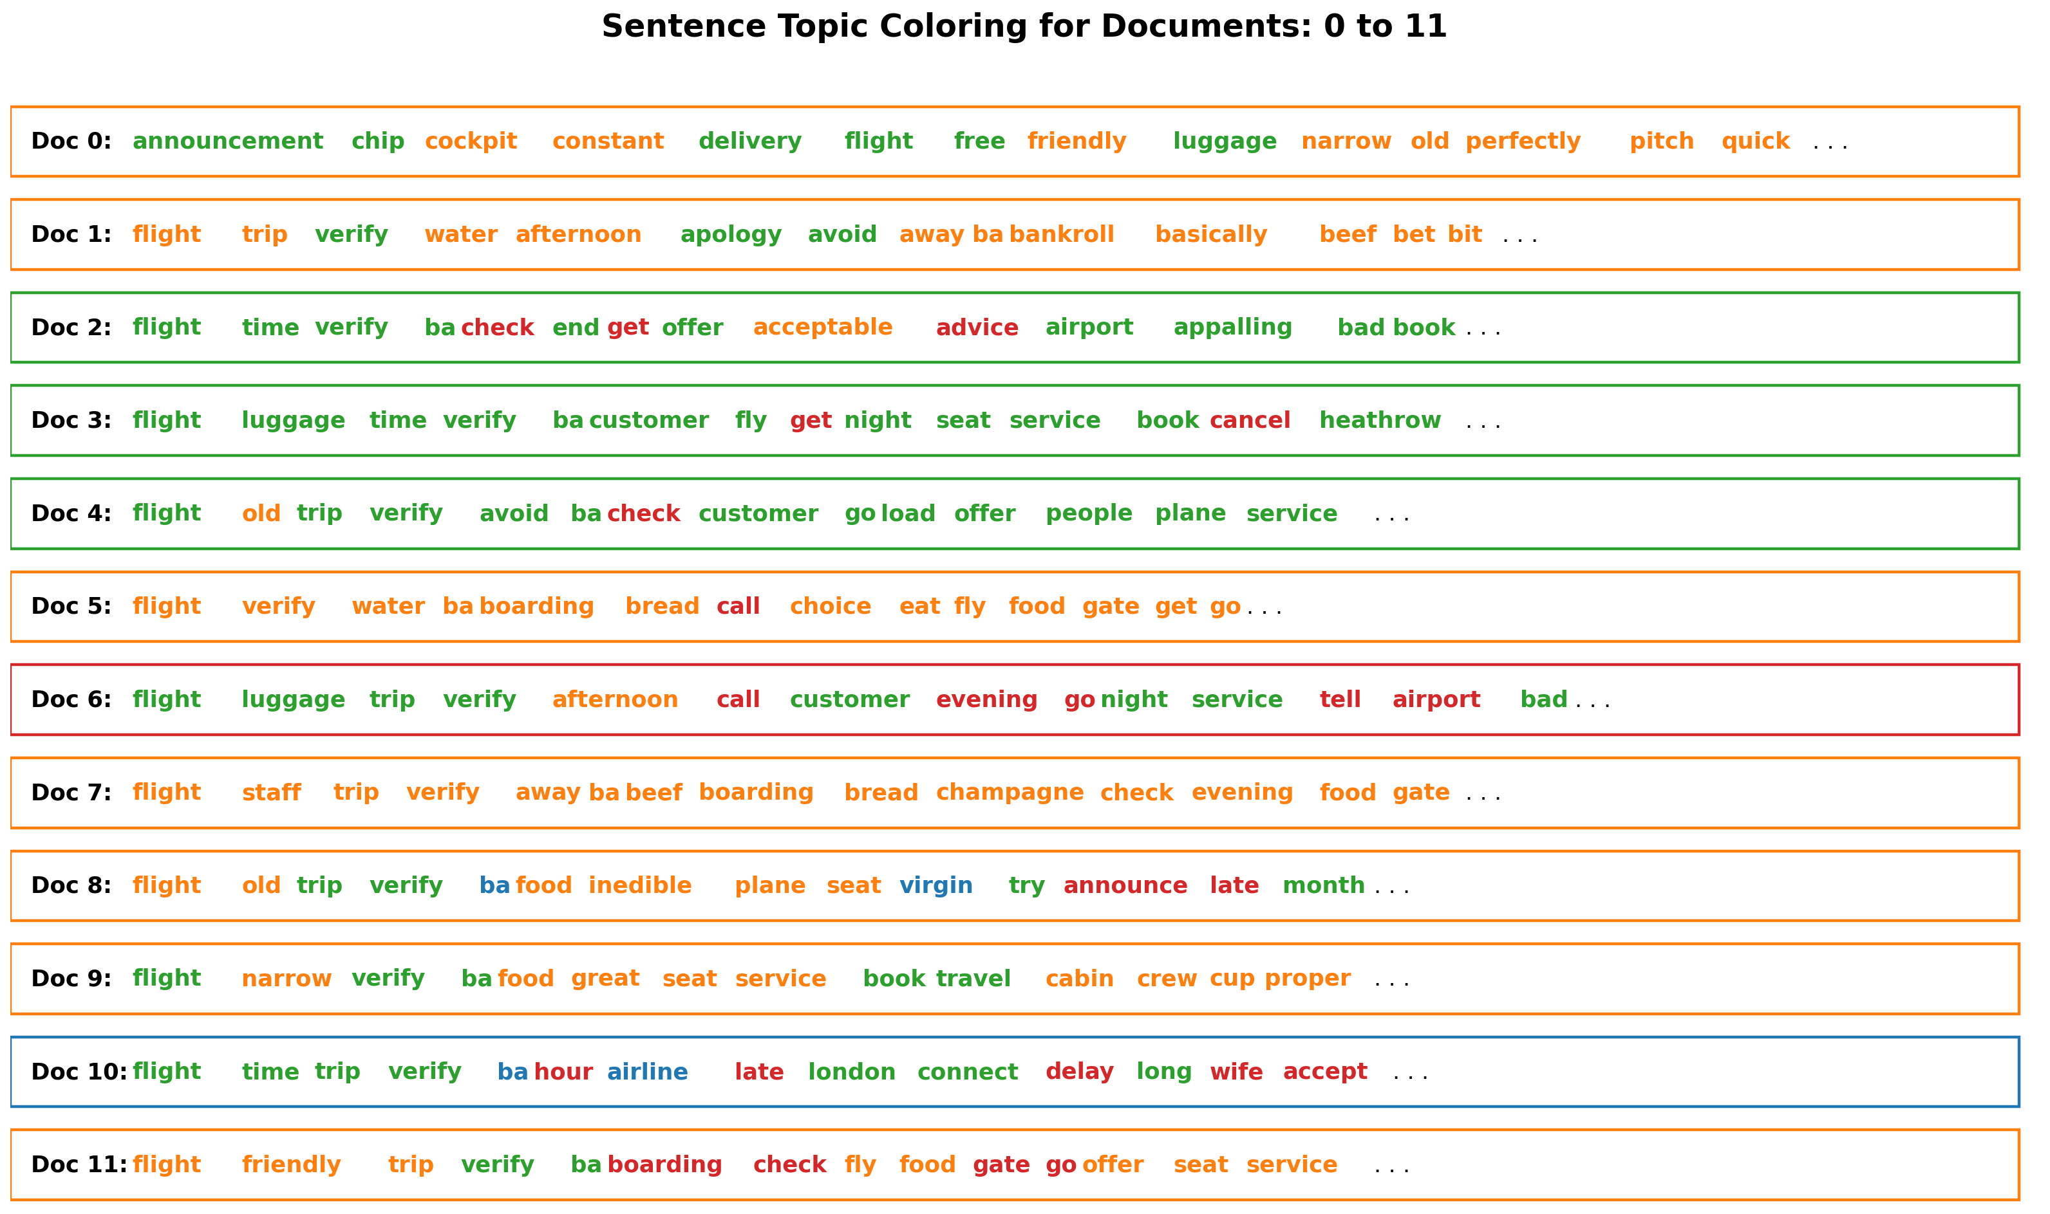
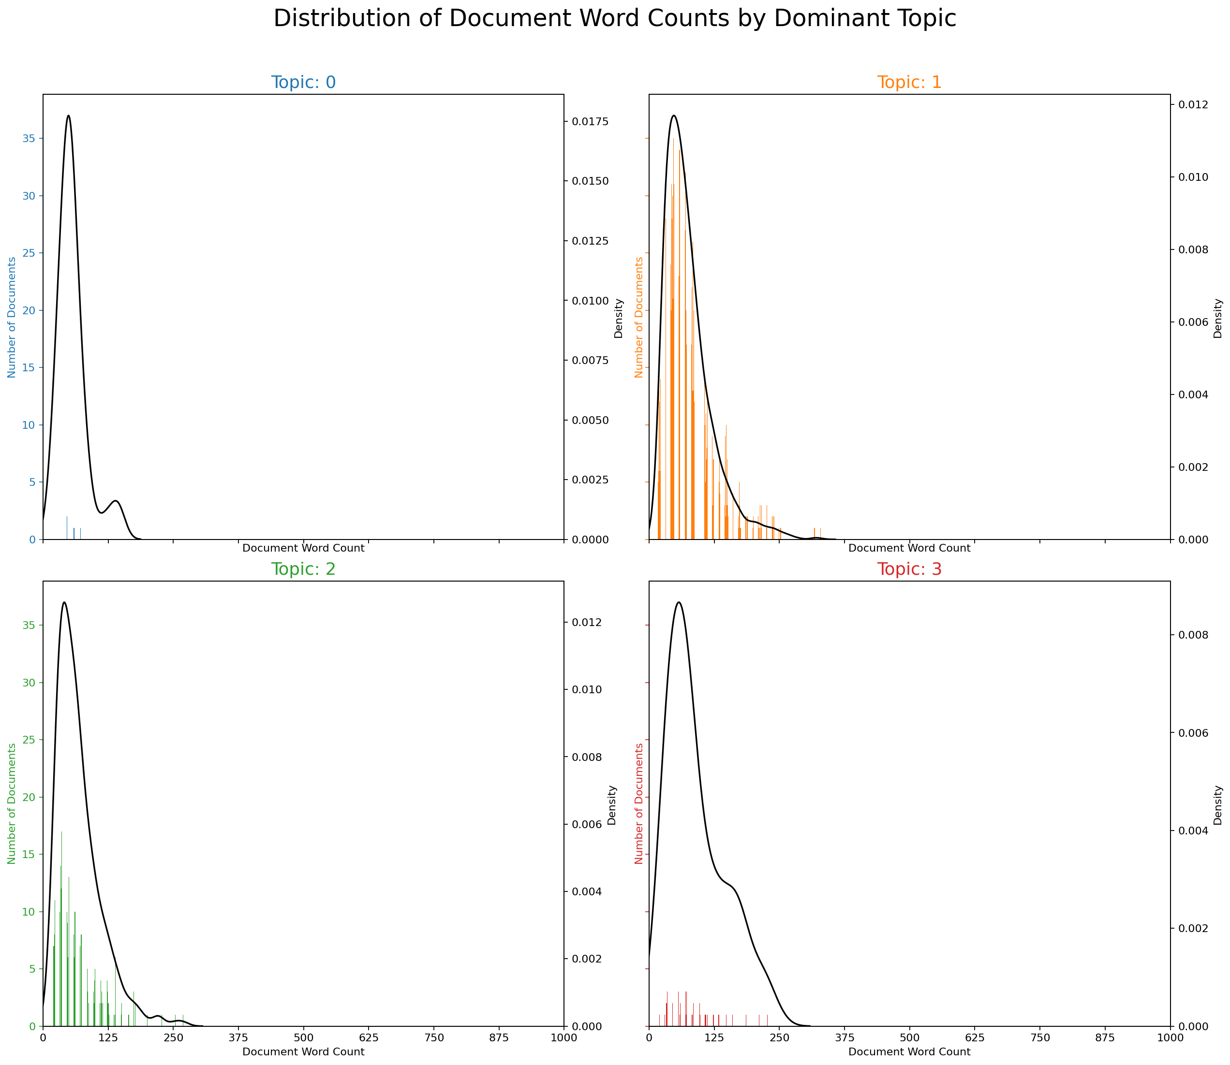
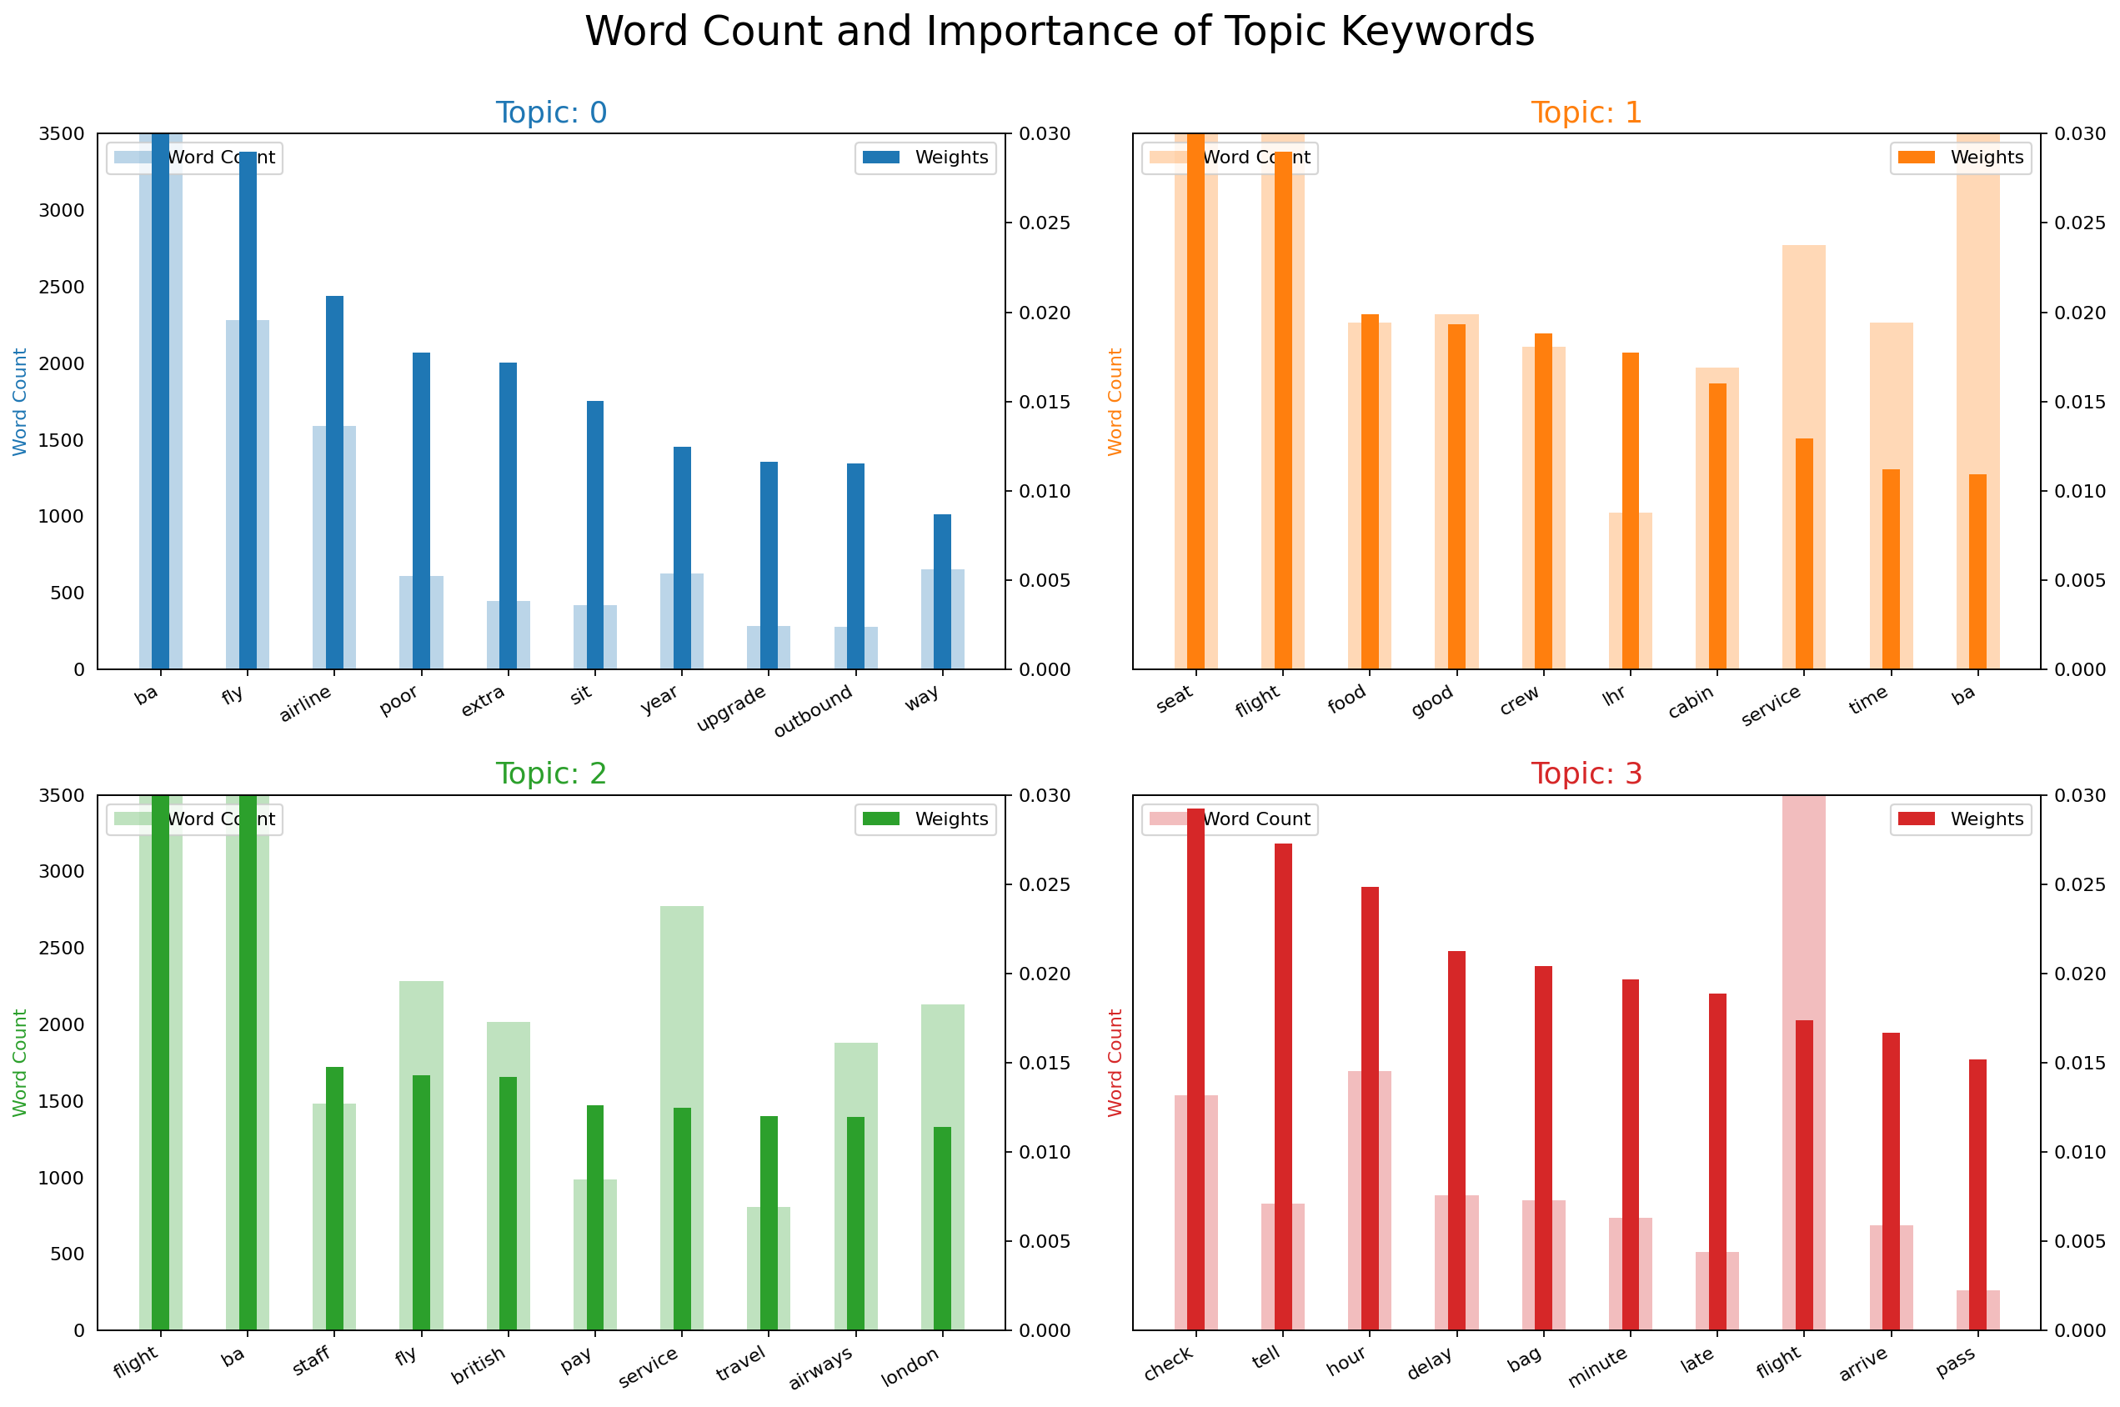
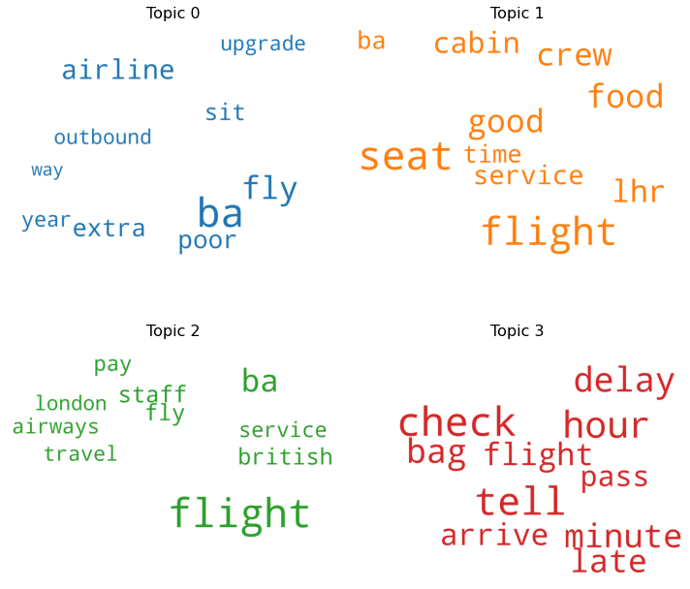
Insights Visualizations from British Airways Customer Reviews Extracted from Skytrax webpage

